Slide 1
Final Mini Project Demonstration
Project Title : Music Genre Classification
Project Guide : Prof. K S Srinivas
Project Team : Rushika B Prasad (PES1201801645)

Slide 2
Project Abstract and Scope
In present times, the data is voluminous in all the fields, namely - engineering, medical, art, etc., making it hard for us to keep track of many such things.
One such voluminous and wide variety of data is observed in the music field. There is a copious number of genres in the music field such as classical, blues, metal, hiphop, etc., making it very difficult for people to remember everything.
In order to ease the lives of people we have designed a model or the application that classifies a song/music to its respective genre (Music genre classifier) using machine learning techniques.

Slide 3
Literature Survey
PREVIOUS PAPERS | IMPLEMENTED PAPER
Earlier papers have used various machine learning methodologies such as RNN, SVM, KNN, Naive Bayes, LSTM, Decision Trees. | In this paper we have used a popular machine learning technique, Convolution Neural Network (CNN).
A few papers have used CNN technique for genre classification but the accuracy that is achieved is very less that is around 47% and 55%. | In this paper we have implemented CNN model and could achieve an accuracy of 81%.
The papers various feature extraction methods such as scattering transform, etc., | The feature extraction method utilised in our paper is Mel-Frequency Cepstral Coefficient (MFCC).

Slide 4
Paper-1
Prasenjeet Fulzele, Rajat Singh, Naman Kaushik, Kavita Pandey, “A Hybrid model for Music Genre Classification using LSTM and SVM”, Dept. of Computer Science, Jaypee Institute of Information Technology, Uttar Pradesh, India. Proceedings of 2018 Eleventh International Conference on Contemporary Computing (IC3), 2-4 August, 2018, Noida, India.
Data: GTZAN music data
Summary:
The paper describes the various steps applied to classify the music into respective genres. The proposed methodology is the Long-Short Term Memory (LSTM) Neural Network and Support Vector Machines (SVM). The dataset is divided into training and validation data in the ratio 90:10 respectively.
The two models LSTM model and SVM model are first trained separately and then combined as well to give the final prediction.
The feature extraction was performed which gave 9 features and that was fed as an input to the LSTM neural network for classification. The model is trained using the SVM model as well.
To combine the two models they have summed up the posterior probabilities of all the files. The accuracy obtained when only LSTM algorithm applied is 69% and when SVM algorithm is applied the accuracy is 84%. But the combined model (SVM and LSTM model) outperformed the other by achieving an accuracy of 89%.

Slide 5
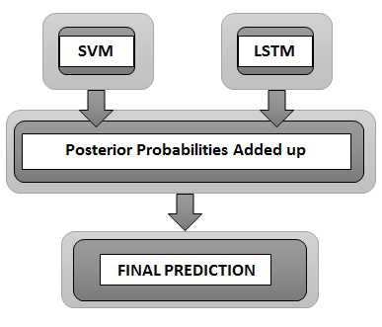
Paper-1
Flowchart:

Slide 6
Paper-2
Vishnupriya S, K.Meenakshi “Automatic Music Genre Classification using Convolutional Neural Network”, SRM UNIVERSITY, Chennai, India. 2018 International Conference on Computer Communication and Informatics (ICCCI -2017), Jan. 04 – 06, 2018, Coimbatore, India.
Data: Million Song Dataset (MSD)
Summary:
The paper suggests a method to classify music into a particular genre it belongs to. In this paper they have used convolution neural network (CNN).
In order to extract a feature they have used Fourier Transformation of the signal. The feature vectors obtained from these signals is called Mel Frequency Cepstral Coefficients (MFCC).
The proposed methodology in the paper is CNN to train the model. The CNN model is fed with the feature that is extracted as an input and the model is trained.
The dataset is divided into two parts that is training and validation with 80:20 ratio respectively. The accuracy achieved is 47% for MFCC feature vectors.

Slide 7
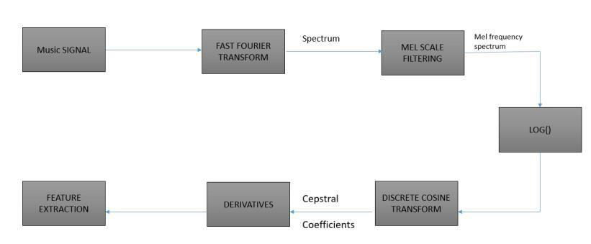
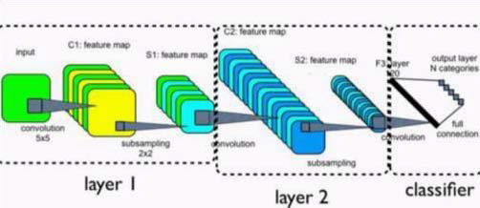
Paper-2
Feature Extraction flowchart
CNN Classifier

Slide 8
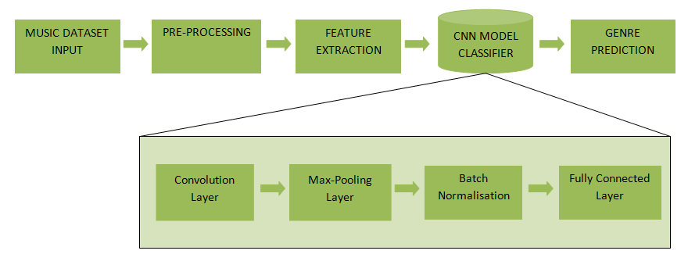
Design Description/UI Design
MUSIC GENRE CLASSIFICATION PROCESS:

Slide 9
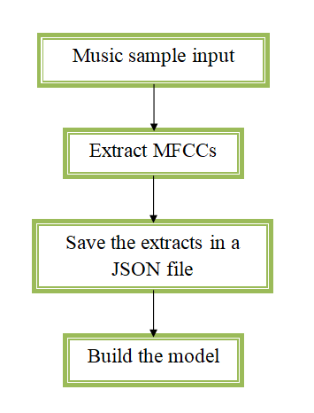
Design Description/UI Design
FEATURE EXTRACTION PROCESS:

Slide 10
Technologies Used
Various Technologies used to complete the project successfully are listed below:
Programming language used: Python (3.6.0)
Tensorflow (2.6.0) and Keras (2.6.0) for implementing the CNN model.
Various python packages such as librosa for analysing the music, sklearn package for the splitting the dataset, numpy, pandas, seaborn, json modules for their respective uses.
Notes:
‹#›

Slide 11
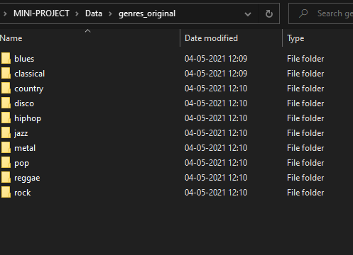
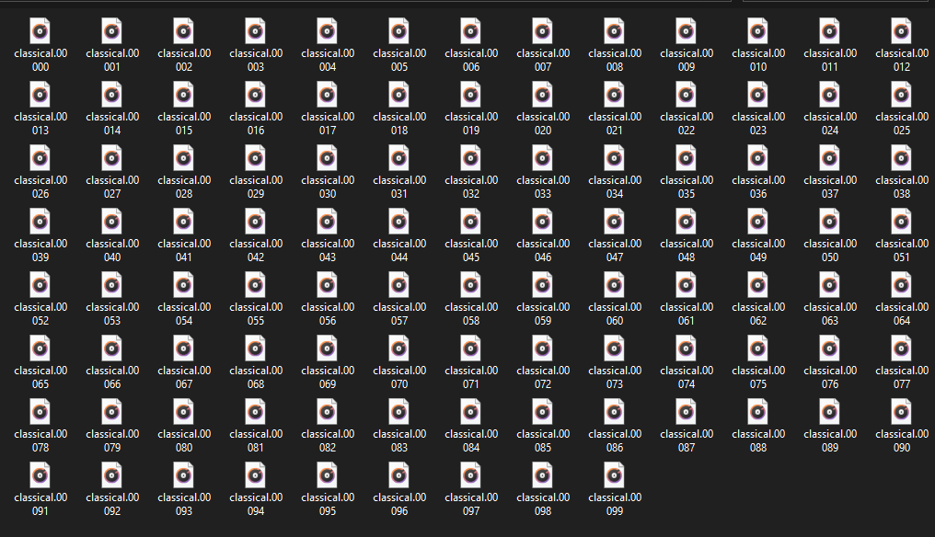
GTZAN Music Dataset
List of 10 different genres in the dataset
Music Sample in each genre
Notes:
‹#›

Slide 12
Implementation
Stage-1: Feature Extraction
Feature Extraction is done using Mel-Frequency Cepstral Coefficient (MFCC).
MFCC is a set of 10-20 features succinctly describes the overall shape of the spectral envelope.
The shape of MFCCs is printed to know the number of MFCCs calculated on the number of frames.
The features are stored into a Json file which is used by the classifier in the next stage.
Notes:
‹#›

Slide 13
Implementation
Stage-2: CNN Classifier
The dataset that is considered is split into 80:20 ratio which is training and testing respectively.
Classification of the music genre is done using a Convolutional Neural Network algorithm.
The feature extracted are fed as an input to the CNN model classifier for classification and prediction.
The optimizer used in the model is Adam optimizer with a learning rate = 0.001.
Notes:
‹#›

Slide 14

Project Demo
Notes:
‹#›

Slide 15
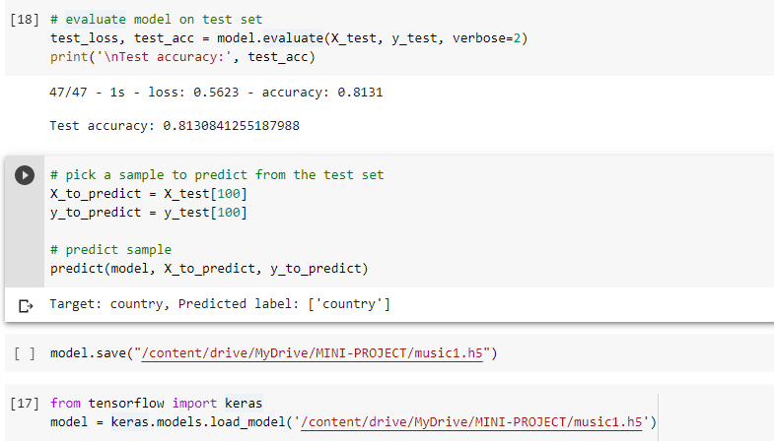
Conclusion and Future Work
The Music Genre Classifier has attained 81% test accuracy using CNN algorithm.
We can further work on improving the accuracy of the classifier.
A music recommendation system can also included with the classifier for recommending the genre that is preferred by the users.
Notes:
‹#›

Slide 16
References
[1] Vishnupriya S and K. Meenakshi, SRM University, Chennai, India,”Automatic Music Genre Classification using Convolution Neural Network”. 2018 International Conference on Computer Communication and Informatics (ICCCI -2017), Jan. 04 – 06, 2018, Coimbatore, INDIA.
[2] Prasenjeet Fulzele, Rajat Singh, Naman Kaushik, Kavita Pandey, Dept. of Computer Science, Jaypee Institute of Information Technology, Uttar Pradesh, India.”A Hybrid Model For Music Genre Classification Using LSTM And SVM”. Proceedings of 2018 Eleventh International Conference on Contemporary Computing (IC3), 2-4 August, 2018, Noida, India.
[3] Nikki Pelchat, Craig M Gelowitz, Software Systems Engineering, University of Regina, Regina, Canada.”Neural Network Music Genre Classification”, 2019 IEEE Canadian Conference of Electrical and Computer Engineering(CCECE).
[4] Congyue Chen, IPQ Organization, Beijing Royal School, Xin Steven, Electronics Engineering and Computer Science, Peking University, Beijing, China.”Combined Transfer and Active Learning for High Accuracy Music Genre Classification Method”. 2021 IEEE 2nd International Conference on Big Data, Artificial Intelligence and Internet of Things Engineering (ICBAIE 2021).
[5] Anirudh Ghildiyal, Komal Singh, Sachin Sharma, Graphic Era Deemed to be University, Dept. of Computer Science and Engineering, Dehradun, Uttarakhand, India.”Music Genre Classification using Machine Learning”. Fourth International Conference on Electronics, Communication and Aerospace Technology (ICECA-2020).
Notes:
‹#›

Slide 17
References
[6] Tom Arjannikov, University of Victoria, British Columbia, Canada, John Z. Zhang, University of Lethbridge, Alberta, Canada, ”An Empirical Study on Structured Dichotomies in Music Genre Classification”. 2015 IEEE 14th International Conference on Machine Learning and Applications.
[7] Ahmet Elbir, Hilmi Bilal Çam, Mehmet Emre İyican, Berkay Öztürk, Nizamettin Aydın, Computer Engineering Department, Yildiz Technical University, Istanbul, Turkey. ”Music Genre Classification and Recommendation by Using Machine Learning Techniques”. 2018 IEEE.
[8] Wenli Wu, Guangxiao Song, Zhijie Wang, Fang Han, College of Information Science and
Technology, Donghua University, Shanghai, China. ”Music Genre Classification Using Independent Recurrent Neural Network”, 2018 IEEE.
[9] Snigdha Chillara, Kavitha A S, Shwetha A Neginhal, Shreya Haldia, Vidyullatha K S, Department of Information Science and Engineering, Dayananda Sagar College of Engineering, Bangalore,Karnataka, India. ”Music Genre Classification using Machine Learning Algorithms: A comparison”. 2019 International Research Journal of Engineering and Technology (IRJET).
Notes:
‹#›

Slide 18
Thank You

